Slide 1
Software Engineering
Agile Development Process

Slide 2
Software and Rock Climbing
Team
Individuals with talent
Skill sensitive
Training
Tools
Resource-limited: before nightfall or the weather changes.
Plan
Improvised

Slide 3
Agile
Agile is an iterative approach to project management and software development that helps teams deliver value to their customers faster and with fewer headaches. ... Requirements, plans, and results are evaluated continuously so teams have a natural mechanism for responding to change quickly.
In software development, agile practices approach discovering requirements and developing solutions through the collaborative effort of self-organizing and cross-functional teams and their customer/end user.
Agile software development refers to a group of software development methodologies based on iterative development, where requirements and solutions evolve through collaboration between self-organizing cross-functional teams. ... Read more about the Agile Manifesto.

Slide 4
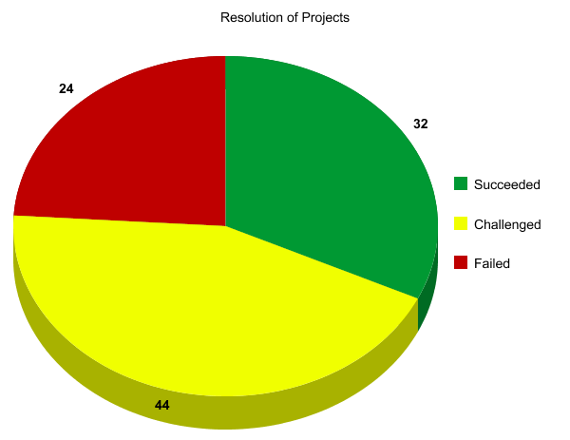
The Standish “Chaos” Report
Reports on statistics about IT
projects (data for 2019-20)
32% of all projects succeeded (delivered on time, on budget, with required features and functions)
44% are challenged (late, over budget and/or with less than the required features and functions)
24% have failed (cancelled prior to completion or delivered and never used)
Among the suspected causes: poor estimates and poor planning

Slide 5

Software Development Process
Generic plan for a software project
What has to be done? (-> tasks/activities/steps)
Why do a task? (-> outcomes, produced artifacts)
When should it be done? (-> schedule)
Who does it? (-> people, roles, responsibilities)
How should it be done? (-> methods, standards, tools)
Many different processes exist
No single process suitable for every project (no “one size fits all”)

Slide 6

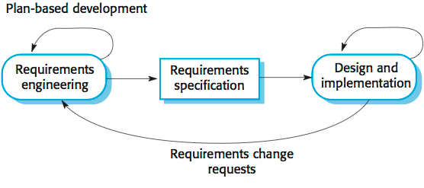
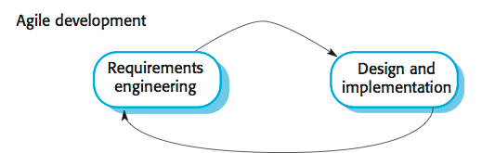
Software Development Processes Plan-driven and agile processes
Plan-driven processes are processes where all of the process activities are planned in advance and progress is measured against this plan.
In agile processes, planning is incremental and it is easier to change
the process to reflect changing customer requirements.
In practice, most practical processes include elements of both plan-driven and agile approaches.
There are no right or wrong software processes.

Slide 7
Software Process Models
The waterfall model
Plan-driven model. Separate and distinct phases of specification and development.
Incremental development
Specification, development and validation are interleaved. May be plan-driven or agile.
Reusable Integration and configuration
The system is assembled from existing configurable components. May be plan-driven or agile.
In practice, most large systems are developed using a process that incorporates elements from all of these models.

Slide 8
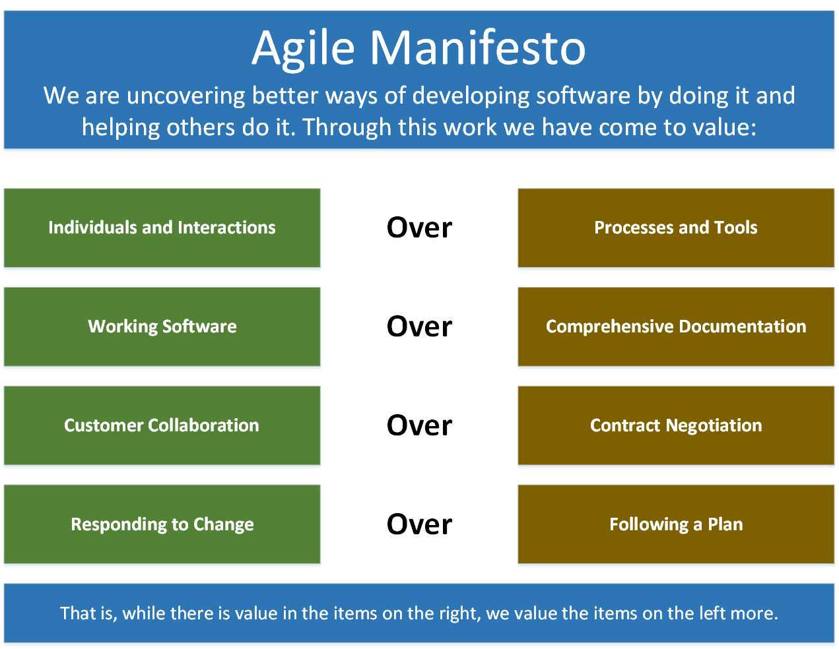
Agile Manifesto
The Agile Manifesto is based on 12 principles
Customer satisfaction by rapid delivery of useful software
Welcome changing requirements, even late in development
Working software is delivered frequently (weeks rather than months)
Close, daily cooperation between business people and developers
Projects are built around motivated individuals, who should be trusted
Face-to-face conversation is the best form of communication (co-location)
Working software is the principal measure of progress
Sustainable development, able to maintain a constant pace
Continuous attention to technical excellence and good design
Simplicity—the art of maximizing the amount of work not done—is essential
Self-organizing teams
Regular adaptation to changing circumstance

Slide 9
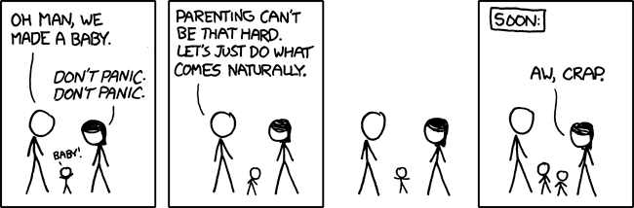
agile – “doing what come naturally”
Not always the best idea, but let’s give it a try

Slide 10
Manifesto for Agile Software Development
“We are uncovering better ways of developing software by doing it and helping others do it. Through this work we have come to the value:
Individuals and interactions over processes and tools
Working software over comprehensive documentation
Customer collaboration over contract negotiation
Responding to change over following a plan
That is, while there is value in the items on the right, we value the items on the left more.”
Let’s look at these values to discern exactly what is meant.

Slide 11
Value 1: Individuals and Interactions over Processes and Tools
Strong players: a must, but can fail if don’t work together.
Strong player: not necessarily an ‘ace;’ work well with others!
Communication and interacting is more important than raw talent.
‘Right’ tools are vital to smooth functioning of a team.
Start small. Find a free tool and use until you can demo you’ve outgrown it. Don’t assume bigger is better. Start with white board; flat files before going to a huge database.
Building a team more important than building environment.
Some managers build the environment and expect the team to fall together.
Doesn’t work.
Let the team build the environment on the basis of need.

Slide 12
Value 2: Working Software over Comprehensive Documentation
Code – not ideal medium for communicating rationale and system structure.
Team needs to produce human readable documents describing system and design decision rationale.
Too much documentation is worse than too little.
Take time; more to keep in sync with code; Not kept in sync? it is a lie and misleading.
Short rationale and structure document.
Keep this in sync; Only highest level structure in the system kept.

Slide 13
Value 2: Working Software over Comprehensive Documentation
How to train new bees if short & sweet?
Work closely with them.
Transfer knowledge by sitting with them; make part of team via close training and interaction.
Two essentials for transferring info to new team members:
Code is the only unambiguous source of information.
Team holds every-changing roadmap of systems in their heads; cannot put on paper.
Best way to transfer info- interact with them.
Fatal flaw: Pursue documentation instead of software:
Rule: Produce no document unless need is immediate and significant.

Slide 14
Value 3: Customer Collaboration over Contract Negotiation
Not possible to describe software requirements up front and leave someone else to develop it within cost and on time.
Best contracts are NOT those specifying requirements, schedule and cost.
Become meaningless shortly.
Far better are contracts that govern the way the development team and customer will work together.
Customers cannot just cite needs and go away
Successful projects require customer feedback on a regular and frequent basis – and not dependent upon a contract or SOW.
Key is intense collaboration with customer and a contract that governed collaboration rather than details of scope and schedule
Details ideally not specified in contract.
Rather contracts could pay when a block passed customer’s acceptance tests.
With frequent deliverables and feedback, acceptance tests never an issue.

Slide 15
Value 4: Responding to Change over Following a Plan
Our plans and the ability to respond to changes is critical!
Course of a project cannot be predicted far into the future.
Too many variables; not many good ways at estimating cost.
Tempting to create a PERT or Ghant chart for whole project.
This does Not give novice managers control.
Can track individual tasks, compare to actual dates w/planned dates and react to discrepancies.
But the structure of the chart will degrade
As developers gain knowledge of the system and as customer gains knowledge about their needs, some tasks will become unnecessary; others will be discovered and will be added to ‘the list.’
In short, the plan will undergo changes in shape, not just dates.

Slide 16
Value 4: Responding to Change over Following a Plan
Better planning strategy – make detailed plans for the next few weeks, very rough plans for the next few months, and extremely crude plans beyond that.
Need to know what we will be working on the next few weeks; roughly for the next few months; a vague idea what system will do after a year.
Only invest in a detailed plan for immediate tasks; once plan is made, difficult to change due to momentum and commitment.
But rest of plan remains flexible. The lower resolution parts of the plan can be changed with relative ease.

Slide 17
Agile Principles (12)
The following principles are those that differentiate agile processes from others.
Agile principles support observing changing markets, customer needs, and competitive threats and changing course when necessary.
Early and Continuous Delivery of Valuable Software.
Embrace Change.
Frequent Delivery.
Business and Developers Together.
Motivated Individuals. ...
Face-to-Face Conversation.
Working Software.
Technical Excellence.
Simplicity
Self Organizing Team
Regular Reflection and Adjustment
They all still matter

Slide 18
Principle 1: Our Highest Priority is to Satisfy the Customer through Early and Continuous Delivery of Valuable Software
Number of practices have significant impact upon quality of final system:
1. Strong correlation between quality and early delivery of a partially functioning system.
The less functional the initial delivery, the higher the quality of the final delivery.
2. Another strong correlation exists between final quality and frequently deliveries of increasing functionality.
The more frequent the deliveries, the higher the final quality.
Agile processes deliver early and often.
Rudimentary system first followed by systems of increasing functionality every few weeks.
Customers my use these systems in production, or
May choose to review existing functionality and report on changes to be made.
Regardless, they must provide meaningful feedback.

Slide 19
Principle 2: Welcome Changing Requirements, even late in Development. Agile Processes harness change for the Customer’s Competitive Advantage.
This is a statement of attitude.
Participants in an agile process are not afraid of change.
Requirement changes are good;
Mean team has learned more about what it will take to satisfy the market.
Agile teams work to keep the software structure flexible, so requirement change impact is minimal.
Moreso, the principles of object oriented design help us to maintain this kind of flexibility.

Slide 20
Principle 3: Deliver Working Software Frequently(From a couple of weeks to a couple of months with a preference to the shorter time scale.
We deliver working software.
Deliver early and often.
Be not content with delivering bundles of documents, or plans.
Don’t count those as true deliverables.
The goal of delivering software that satisfies the customer’s needs.

Slide 21
Principle 4: Business People and Developers Must Work Together Daily throughout the Project.
For agile projects, there must be significant and frequent interaction between the
customers,
developers, and
stakeholders.
An agile project must be continuously guided.

Slide 22
Principle 5: Build Projects around Motivated Individuals. (Give them the environment and support they need, and trust them to get the job done.)
An agile project has people the most important factor of success.
All other factors, process, environment, management, etc., are considered to be second order effects, and are subject to change if they are having an adverse effect upon the people.
Example: if the office environment is an obstacle to the team, change the office environment.
If certain process steps are obstacles to the team, change the process steps.

Slide 23
Principle 6: The Most Efficient and Effective Method of Conveying Information to and within a Development Team is face-to-face Communications.
In agile projects, developers talk to each other.
The primary mode of communication is conversation.
Documents may be created, but there is no attempt to capture all project information in writing.
An agile project team does not demand written specs, written plans, or written designs.
They may create them if they perceive an immediate and significant need, but they are not the default.
The default is conversation.

Slide 24
Principle 7: Working Software is the Primary Measure of Progress
Agile projects measure their progress by measuring the amount of working software.
Progress not measured by phase we are in, or
by the volume of produced documentation or
by the amount of code they have created.
Agile teams are 30% done when 30% of the necessary functionality is working.

Slide 25
Principle 8: Agile Processes promote sustainable development The sponsors, developers, and users should be able to maintain a constant pace indefinitely.
An agile project is not run like a 50 yard dash; it is run like a marathon.
The team does not take off at full speed and try to maintain that speed for the duration.
Rather they run at a fast, but sustainable, pace.
Running too fast leads to burnout, shortcuts, and debacle.
Agile teams pace themselves.
They don’t allow themselves to get too tired.
They don’t borrow tomorrow’s energy to get a bit more done today.
They work at a rate that allows them to maintain the highest quality standards for the duration of the project.

Slide 26
Principle 9: Continuous Attention to Technical Excellence and Good Design enhances Agility.
High quality is the key to high speed.
The way to go fast is to keep the software as clean and robust as possible.
Thus, all agile team-members are committed to producing only the highest quality code they can.
They do not make messes and then tell themselves they’ll clean it up when they have more time.
Do it right the first time!

Slide 27
Principle 10: Simplicity – the art of maximizing the amount of work not done – is essential.
Agile teams take the simplest path that is consistent with their goals.
They don’t anticipate tomorrow’s problems and try to defend against them today.
Rather they do the simplest and highest quality work today, confident that it will be easy to change if and when tomorrows problems arise.

Slide 28
Principle 11: The Best Architectures, Requirements, and Designs emerge from Self-Organizing Teams
An agile team is a self organizing team.
Responsibilities are not handed to individual team members from the outside.
Responsibilities are communicated to the team as a whole, and the team determines the best way to fulfill them.
Agile team members work together on all project aspects.
Each is allowed input into the whole.
No single team member is responsible for the architecture, or the requirements, or the tests, etc.
The team shares those responsibilities and each team member has influence over them.

Slide 29
Principle 12: At regular Intervals, the Team reflects on how to become more effective, then tunes and adjusts its behavior accordingly.
An agile team continually adjusts its organization, rules, conventions, relationships, etc.
An agile team knows that its environment is continuously changing, and knows that they must change with that environment to remain agile.

Slide 30
Problems with agile methods
It can be difficult to keep the interest of customers / users who are involved in the process.
Team members may be unsuited to the intense involvement that characterizes agile methods.
Prioritizing changes can be difficult where there are multiple stakeholders.
Maintaining simplicity requires extra work.
Contracts may be a problem as with other approaches to iterative development.
Because of their focus on small, tightly-integrated teams, there are problems in scaling agile methods to large systems.
Less emphasis on documentation - harder to maintain when you get a new team for maintenance

Slide 31
Conclusions
The professional goal of every software engineer, and every development team, is to deliver the highest possible value to our employers and customers.
And yet, our projects fail, or fail to deliver value, at a dismaying rate.
Though well intentioned, the upward spiral of process inflation is culpable for at least some of this failure.
The principles and values of agile software development were formed as a way
to help teams break the cycle of process inflation, and
to focus on simple techniques for reaching their goals.
At the time of this writing there were many agile processes to choose from. These include
SCRUM,
Crystal,
Feature Driven Development (FDD),
Adaptive Software Development (ADP), and most significantly,
Extreme Programming (XP).
Others…

